Slide 1
Cash Flow Prediction of Mutual Fund
CS532-ML-Project
Group10
Chenglong Li, Jiecheng Han

Slide 2
Content
Background
Data Preprocess
Cashflow Prediction

Slide 3
Background Application scenarios
Yu’e Bao is the most largest Mutual Fund in China, its cash inflow and outflow for millions of its customers must be processed carefully. As one can imagine, predicting future cash flows based on historical data is vital for the fund management.
We will predict future cash flows based on users’ historical purchase and redemption data, to explore the performance of different Machine Learning algorithms and the reason.

Slide 4
Background Main Goal
Get familar with time series data processing and algorithms
Practice different algorithms on time series prediction
Compare performance of different algorithms
Summarize the points when using Machine Learning to predict time series data

Slide 5



Background Techniques

Slide 6
Data preprocess Raw Data
Purchase and redemption sheet: It contains about 2.8 million records, which include the purchase and redemption behaviors during 2013.07.01-2014.08.31, and the information of all sub categories. The data has been desensitized on the premise of basically keeping the original trend.
Attribute | Type | Description | xample
user_id | bigint | User ID | 1234
report_date | string | Date | 20140407
tBalance | bigint | Today' s closing balance | 109004
yBalance | bigint | Yesterday's closing balance | 97389
total_purchase_amt | bigint | Today total purchase = direct purchase + revenue | 21876
total_redeem_amt | bigint | Today's total redemption amount = consumption + transfer amount | 10261

Slide 7
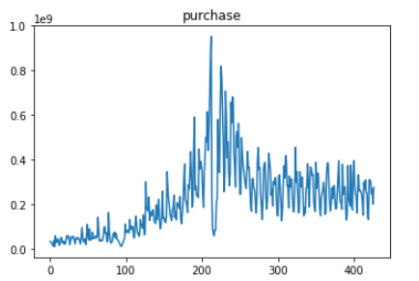
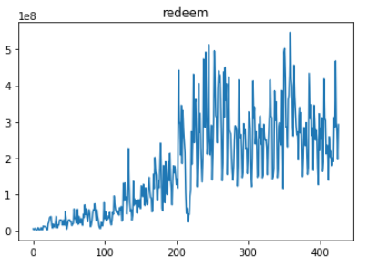
Data preprocess The amount of purchase and redeem everyday

Slide 8
ARIMA Autoregressive integrated moving average
ARIMA is a class of models that captures temporal structures in time series data. ARIMA is a linear regressionbased forecasting approach. Therefore it is best for forecasting one-step out-of-sample forecast. Here, the algorithm developed performs multi-step out-of-sample forecast with re-estimation, i.e., each time the model is re-fitted to build the best estimation model .
ARIMA models are generally denoted ARIMA(p,d,q) where parameters p, d, and q are non-negative integers, p is the order (number of time lags) of the autoregressive model, d is the degree of differencing (the number of times the data have had past values subtracted), and q is the order of the moving-average model.

Slide 9
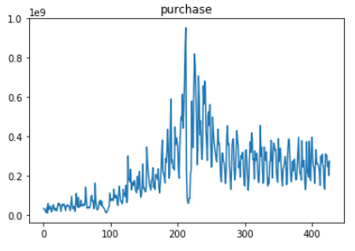
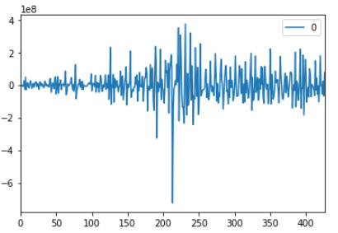
ARIMA Practice
d
ADF: Augmented Dickey–Fuller test
Notes:
In statistics and econometrics, an augmented Dickey–Fuller test (ADF) tests the null hypothesis that a unit root is present in a time series sample. The alternative hypothesis is different depending on which version of the test is used, but is usually stationarity or trend-stationarity. It is an augmented version of the Dickey–Fuller test for a larger and more complicated set of time series models.

Slide 10
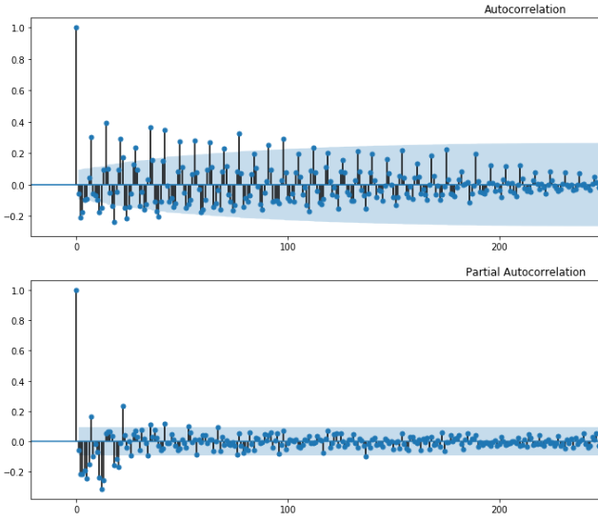
ARIMA Practice
p,q
PACF/ACF: Partial Auto
Correlation Function
AIC: Akaike information
criterion
BIC: Bayesian information
criterion
HQ: Hannan-quinn criterion

Slide 11
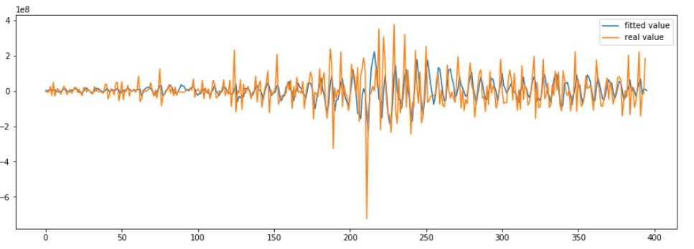
ARIMA Resault

Slide 12
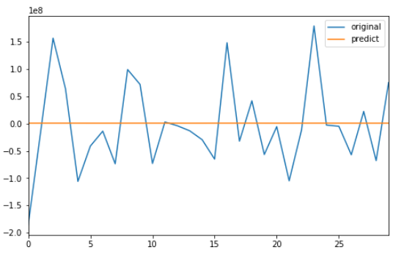
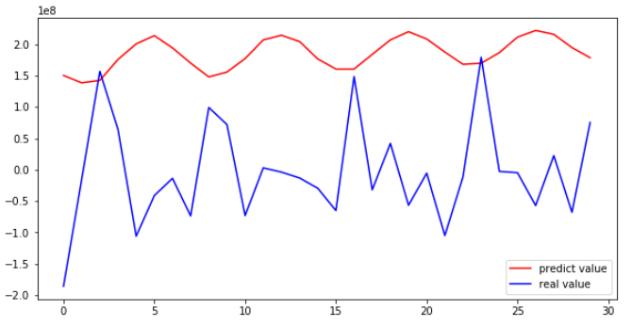
ARIMA Resault

Slide 13
ARIMA Analysis
Good
The general trend
Bad
The trend prediction delay
The value
Reason
p,q parameter
windows memory

Slide 14
ARIMA Further
Seasonal ARIMA models are usually denoted ARIMA(p,d,q)(P,D,Q)m, where m refers to the number of periods in each season, and the uppercase P,D,Q refer to the autoregressive, differencing, and moving average terms for the seasonal part of the ARIMA model.

Slide 15
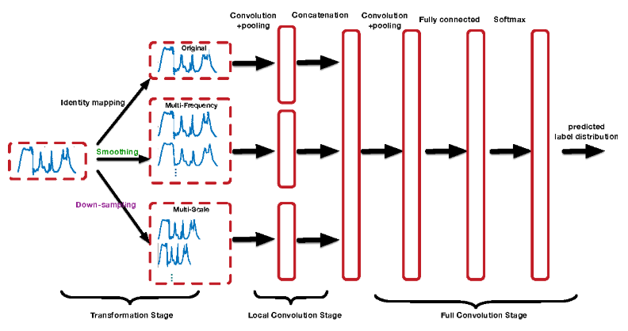
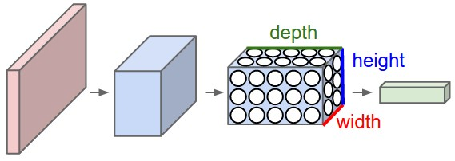
CNN Convolutional neural network

Slide 16
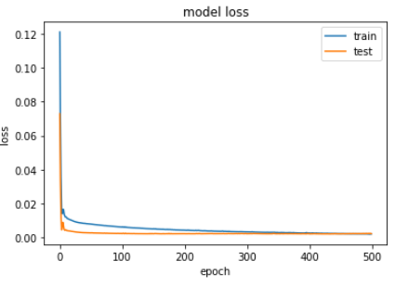
CNN Resault
Overfitting
epoch：500

Slide 17
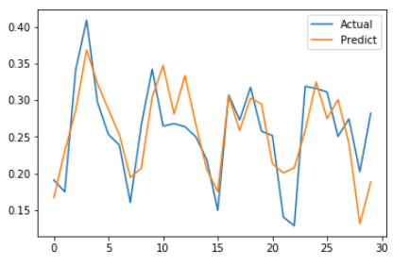
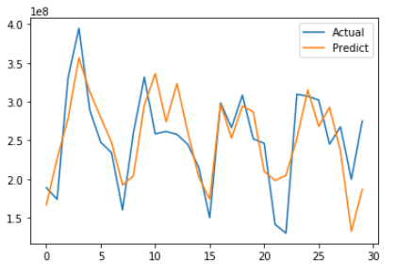
CNN Resault

Slide 18
CNN Analysis
Good
The trend accuracy
The trend delay
Bad
The value accuracy

Slide 19
CNN Further
Input
Multi-variance
Encoding data as image
Multi-channel
Network Frame
RCNN: Recurrent Convolutional NN

Slide 20
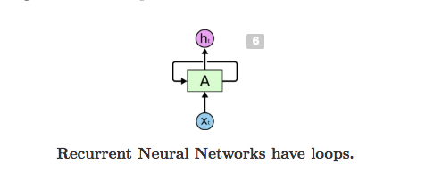
RNN
Imagine you want to classify what kind of event is happening at every point in a movie. It’s unclear how a traditional neural network could use its reasoning about previous events in the film to inform later ones. Recurrent neural networks address this issue. They are networks with loops in them, allowing information to persist.

Slide 21
LSTM - a special RNN
RNN can learn to use the past information, but if the gap between the current data and the past is so large, then RNN don’t seem to be able to learn them. Thankfully, Long Short Term Memory (LSTM) don’t have this problem. It is capable of learning long-term dependencies.
LSTMs are explicitly designed to avoid the long-term dependency problem. Remembering information for long periods of time is practically their default behavior, not something they struggle to learn!

Slide 22
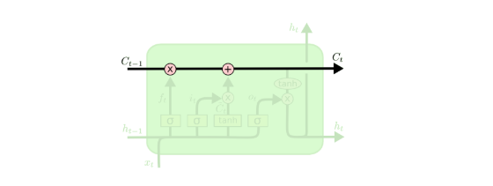
LSTM core idea - cell states
The key to LSTM is the cell state, which is kind of like a conveyor belt. It runs straight down the entire chain, with only some minor linear interactions. It’s very easy for information to just flow along it unchanged.

Slide 23
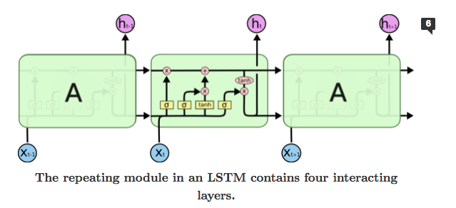
LSTM core idea - gates
The LSTM does have the ability to remove or add information to the cell state, carefully regulated by structures called gates. Including forget gate(forget the information from old subject), input gate(decides which values we’ll update), output gate(decide what we’re going to output).

Slide 24
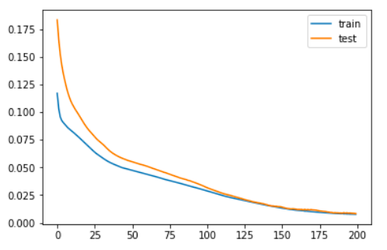
LSTM - Cash in flow prediction

Slide 25
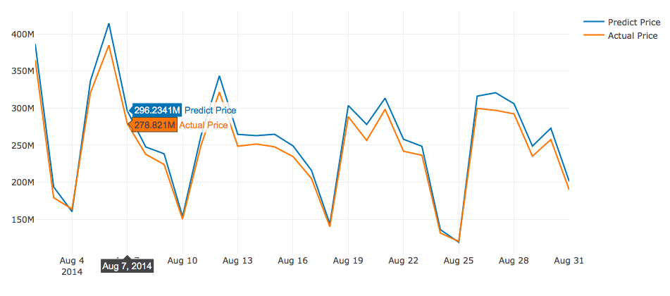
LSTM - Cash in flow prediction

Slide 26
LSTM-disadvantage
LSTM is difficult to train because it requires 4 linear layer (MLP layer) per cell to run at and for each sequence time-step. Linear layers require large amounts of memory bandwidth to be computed. In fact they cannot use many compute unit often because the system has not enough memory bandwidth to feed the computational units. And it is easy to add more computational units, but hard to add more memory bandwidth. As a result, LSTM is not a good match for hardware acceleration

Slide 27
Reference
Predicting_mutual_fund_returns_using_machine_learning_tools, L´aszl´o Jakab, December 10, 2015
A Flow-Based Explanation for Return Predictability, Dong Lou, July, 2012
Mutual Fund Flows and Performance: A Survey of Empirical Findings, Li Ma, 29th March, 2013
http://intelligentonlinetools.com/blog/2017/05/14/time-series-prediction-with-convolutional-neural-networks/
https://medium.com/machine-learning-world/neural-networks-for-algorithmic-trading-2-1-multivariate-time-series-ab016ce70f57
https://link.springer.com/referenceworkentry/10.1007%2F978-1-4614-7750-1_88
https://blog.csdn.net/zkq_1986/article/details/78949510
https://machinelearningmastery.com/multivariate-time-series-forecasting-lstms-keras/
https://towardsdatascience.com/the-fall-of-rnn-lstm-2d1594c74ce0
https://deeplearning4j.org/lstm.html
http://colah.github.io/posts/2015-08-Understanding-LSTMs/

Slide 28
Thanks

